Slide 1


Bike Buying Patterns and Insights for Market Expansion
Presented by DIPU SAHA

Slide 2
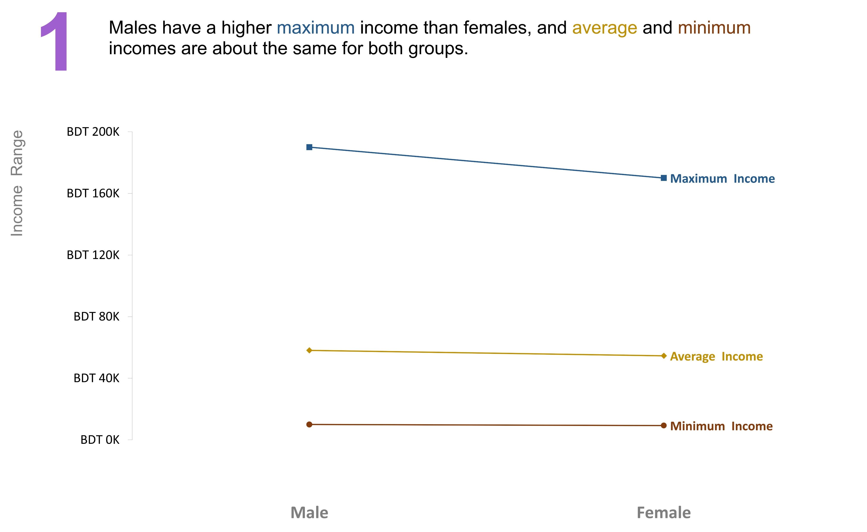
Insights

Slide 3
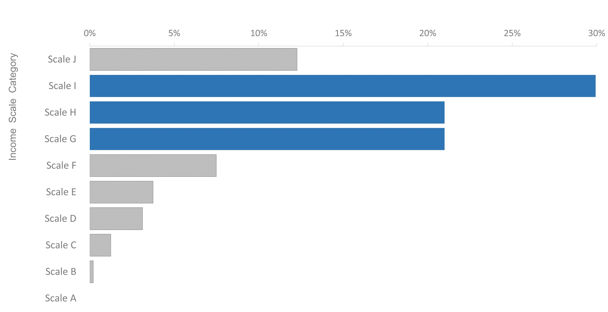
Insights
2
The majority of bike buyers (72%) have a monthly income between BDT 20,001 to BDT 80,000

Slide 4
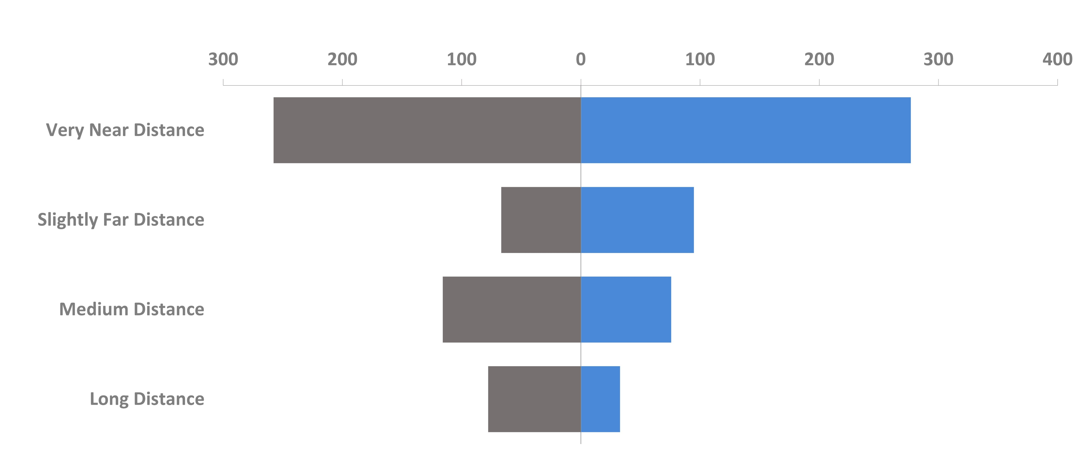
Insights
3
Individuals who commute regularly for 0 to 2 miles purchased bikes the most, followed by others with a substantially lower proportion
NO | YES

Slide 5
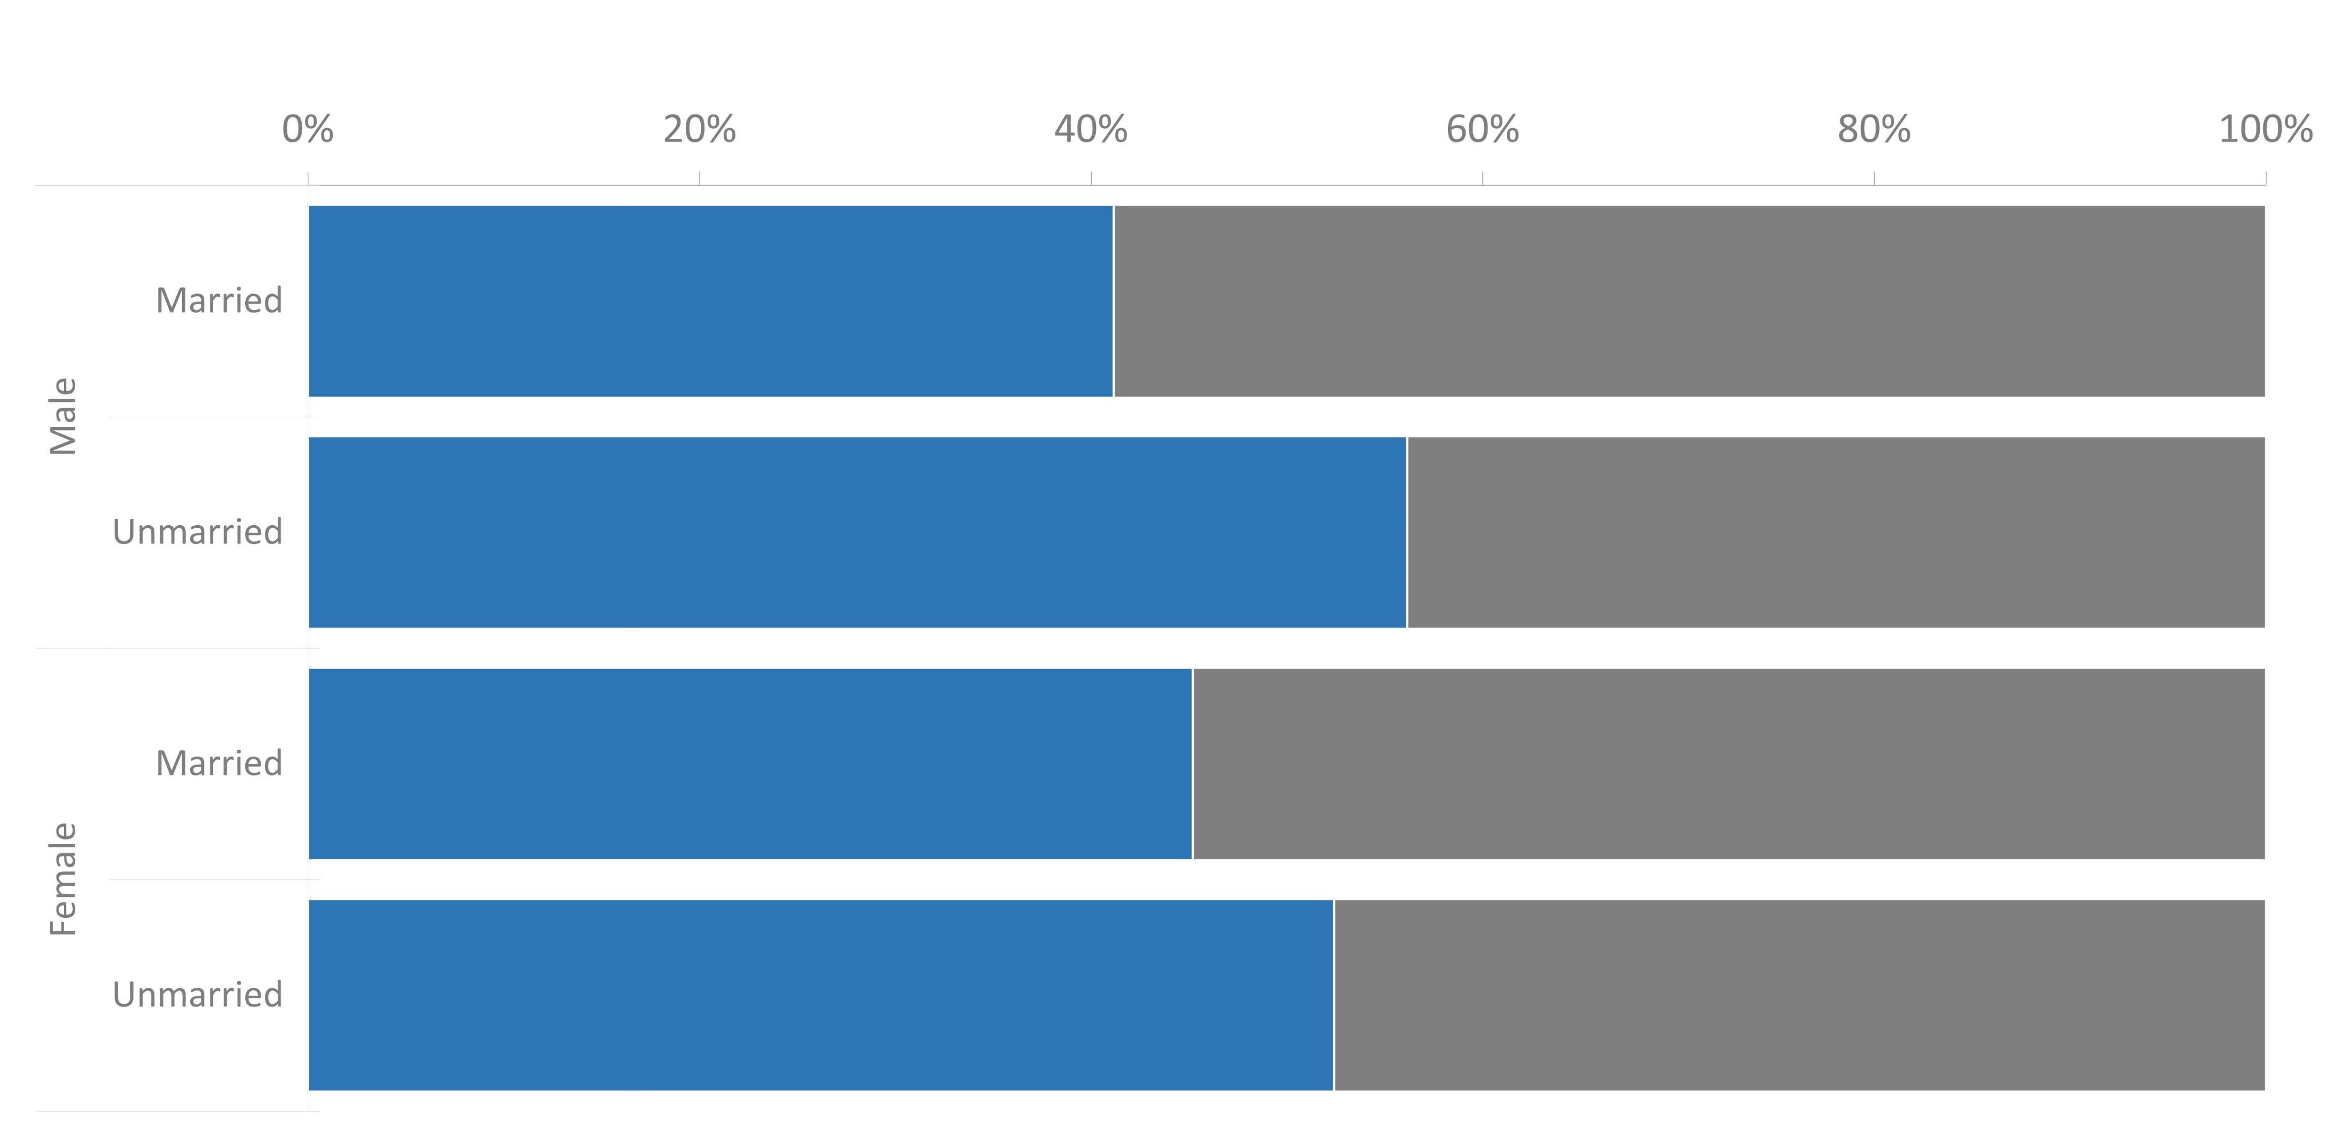
Insights
4
56% of the unmarried male population purchased a bike, followed by the unmarried female population with 52%. Notably, despite the slightly lower percentage, the actual number of bikes purchased by unmarried females is higher than that of unmarried males
YES | NO

Slide 6
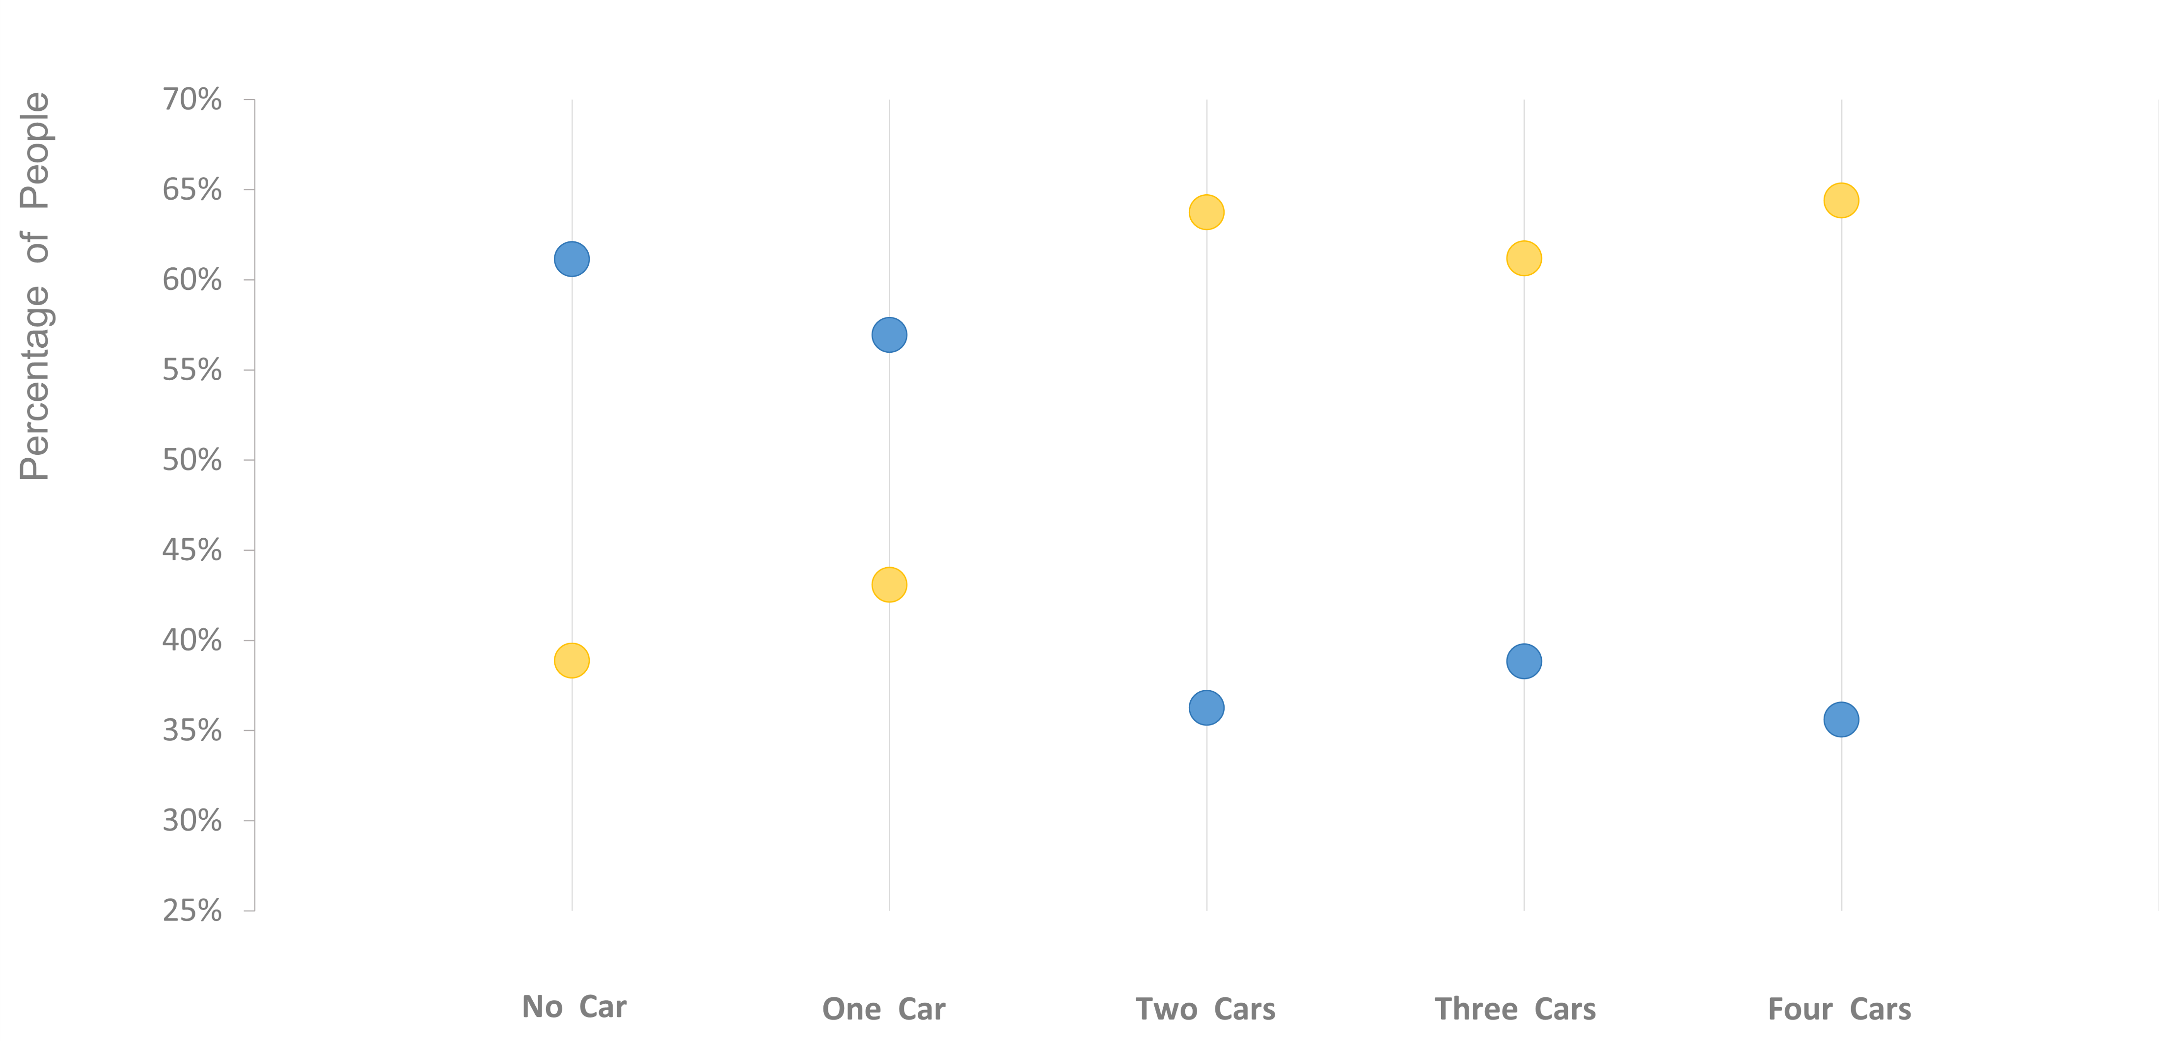
Insights
5
People who have no car or one car are more likely to purchase a bike compared to those who have two or more cars
YES | NO

Slide 7
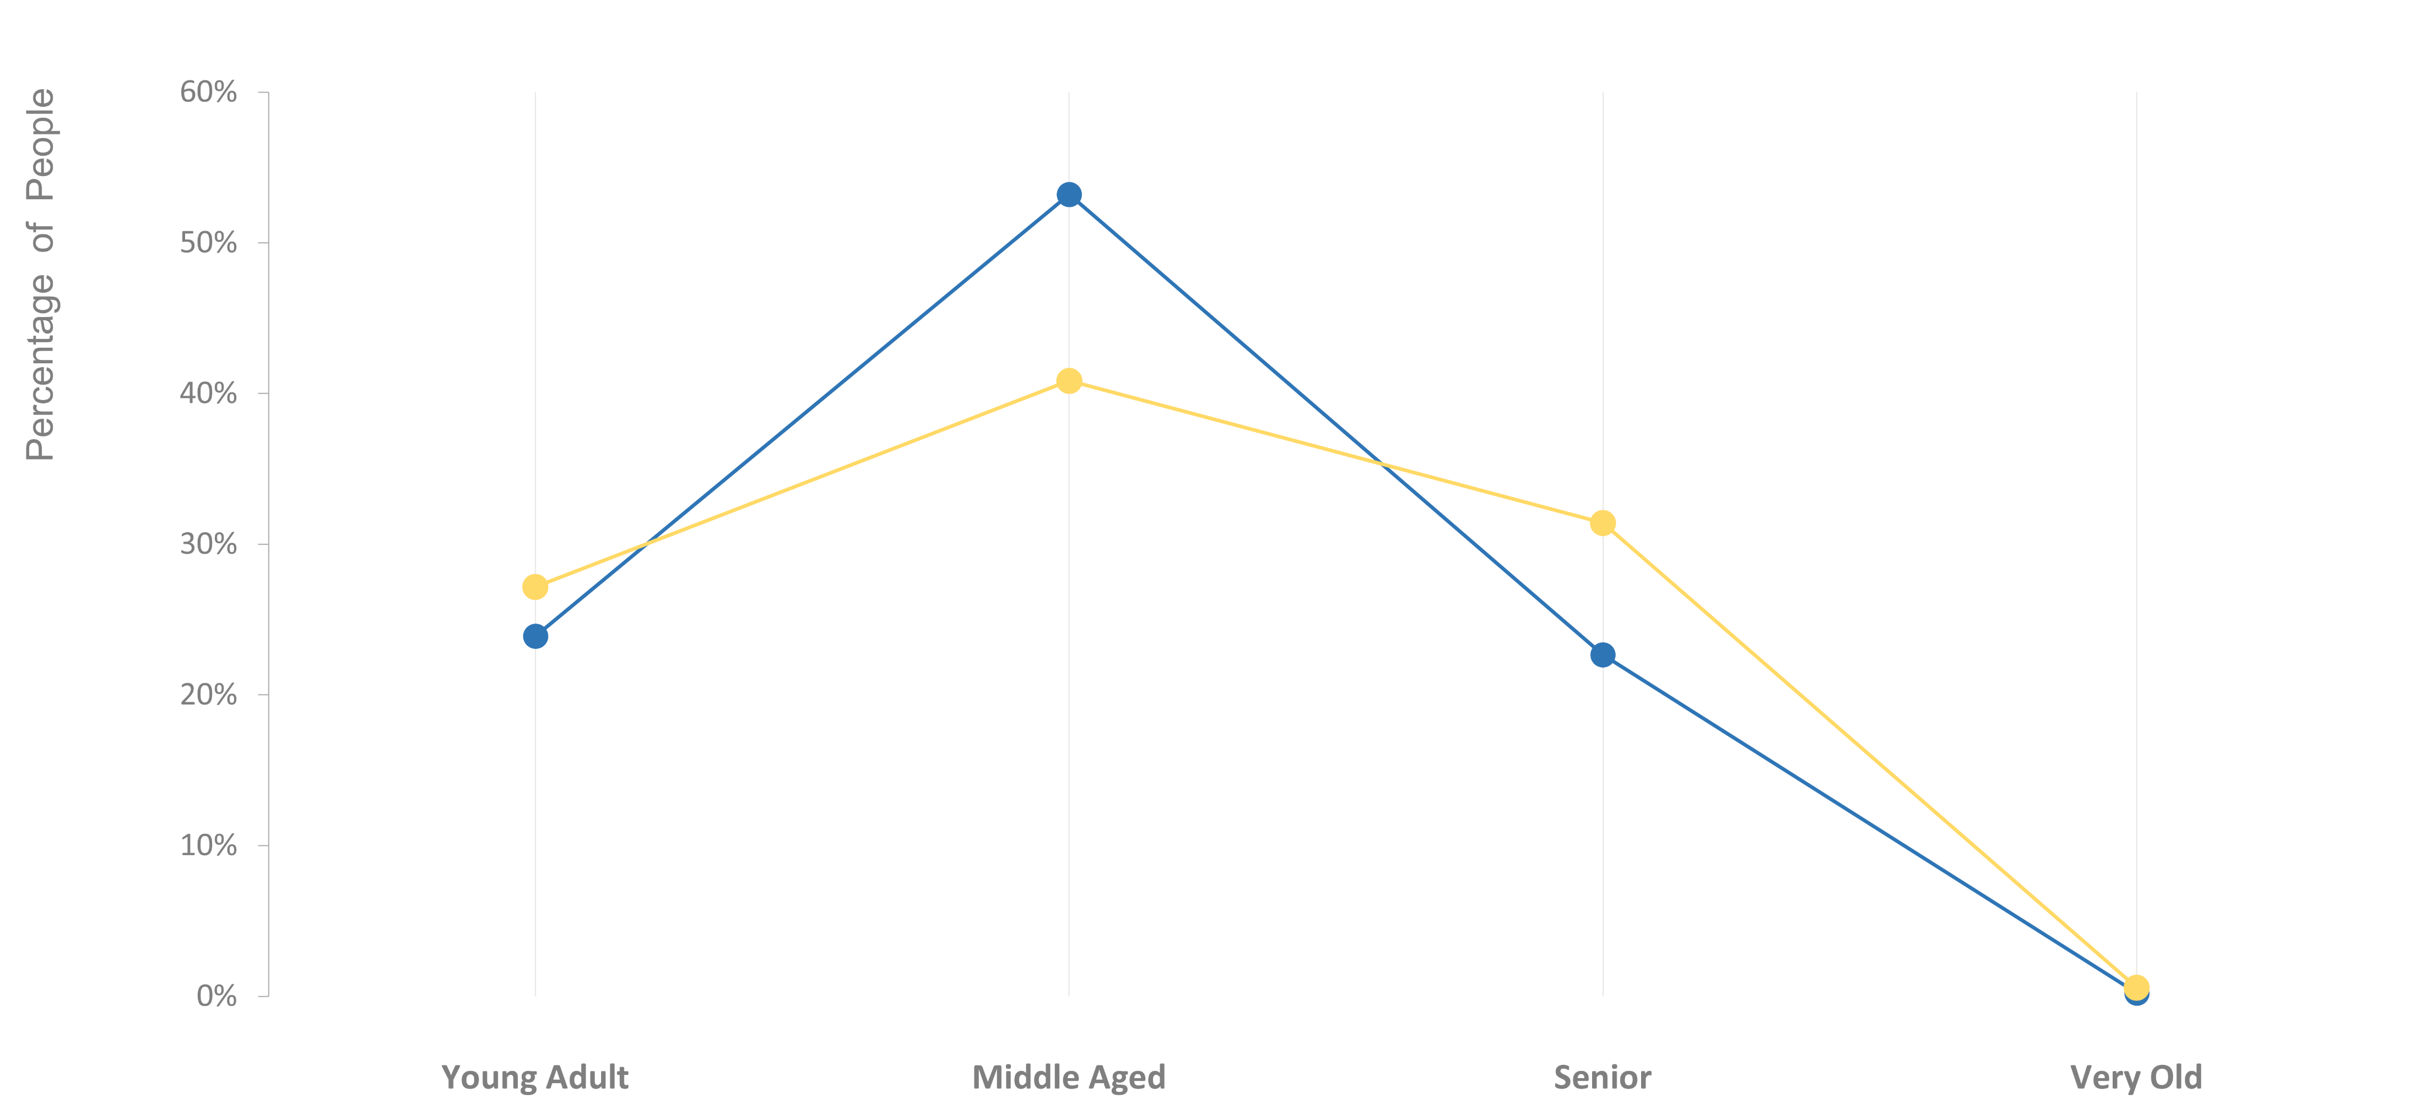
Insights
6
Individuals within the age range of more than 35 to 50 years old purchased bikes more than any other age group
YES | NO

